Slide 1
Multi-dimension aesthetic assessment for game image: a subjective test
Presenter: Junle WANG
Tencent Games
Mar. 09, 2020, VQEG Meeting

Slide 2
Self-introduction
Junle WANG
Working on computer vision, data science in video game, game AI
Tencent: More than WeChat and QQ
Currently the largest video game company in the world
Own Riot Games, big part of Supercell and Epic games, small part of Bluehole, Activision Blizzard, Ubisoft and so on.
Focus on mobile game

Slide 3
Overview
Background
A subjective test on mobile game image aesthetic assessment
Result

Slide 4
What we do to evaluate a game?
Visual analysis (subjective scoring, 5 scales, similar ACR)
Overall score
Color(harmony, colorfulness)
Fineness
Distant view
Interaction effect
Lighting/shadow effect
Model size consistency
Action/movement
Image style
Visual Effect
…
Audio (subjective scoring, 5 scales)
Immersive(questionnaire)
Control (objective + subjective scoring)
Mobile performance (objective, i.e. CPU, FPS, Memory, Temperature)
less subjective
less prior knowledge
less top-down related factors

Slide 5
Background
Image Aesthetic Assessment
Application:
Selection of photos/cover images
Image enhancement
Challenge
Higher level and more subjective factors
Usually no reference
Progress
Either by specific rules, or by neural network
Natural content / photographic (AADB, AVA, …)
Little study is about CG, particular video game image
Our motivation
Game evaluation
Game design
Anormal detection
Game image quality assessment and cloud gaming

Slide 6
Challenges
Personal preference on game
Different picture styles
Pixelization style
Simple style
Realistic style
Influence of UI
VFX
Always evolving

Slide 7
Experiment
Stimuli
100 games collected from Play Store
Some game types are filtered out：
Casino
Teaching
AR/MR
Q&A challenge
1091 screenshot images in total
Some images are filtered out:
UI for setup,
Advertising image included,
Natural content,
OS image related

Slide 9
Experiment
Task
Evaluate each image based on four dimensions
Fineness
Colorfulness
Color harmony
Overall score
Observers are asked to give a 1 to 5 score to each dimension

Slide 10
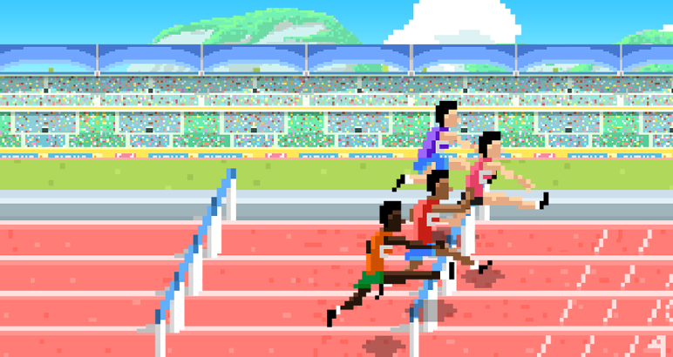
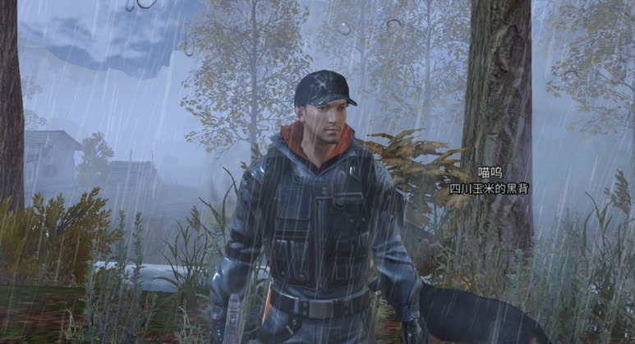
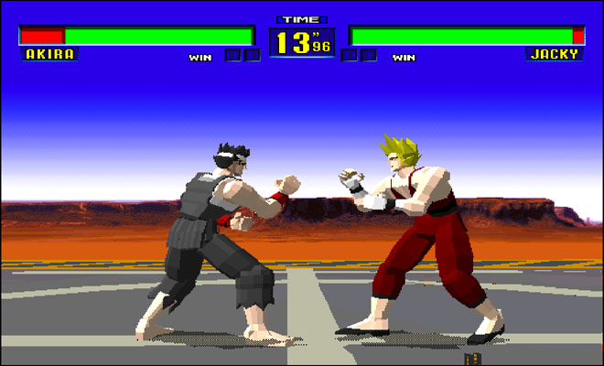
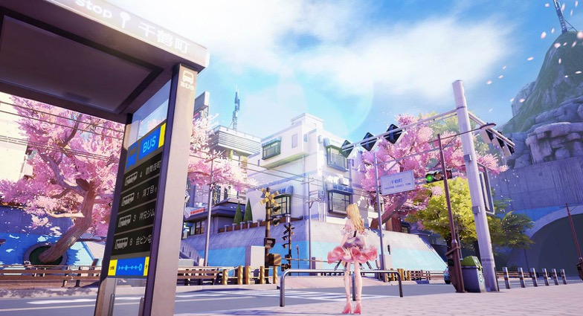
Fineness
Do you think the details are enough and clearly presented?
Score 1
Score 5

Slide 11
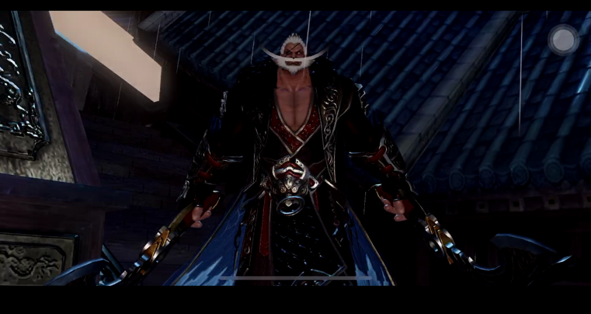
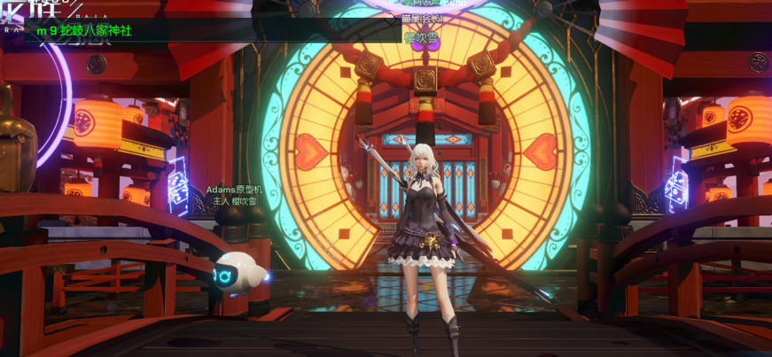
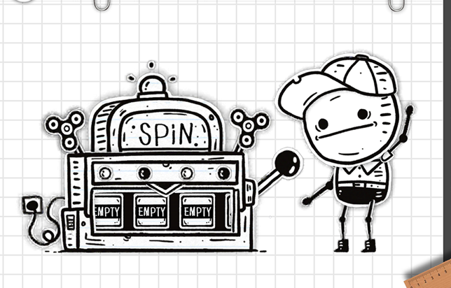
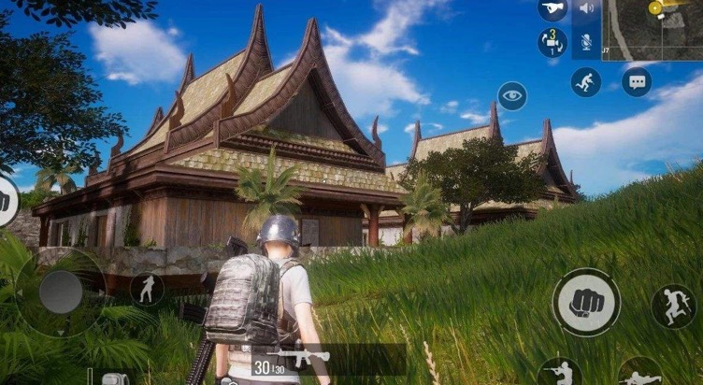
Colorfulness
Score 1
Score 5

Slide 12
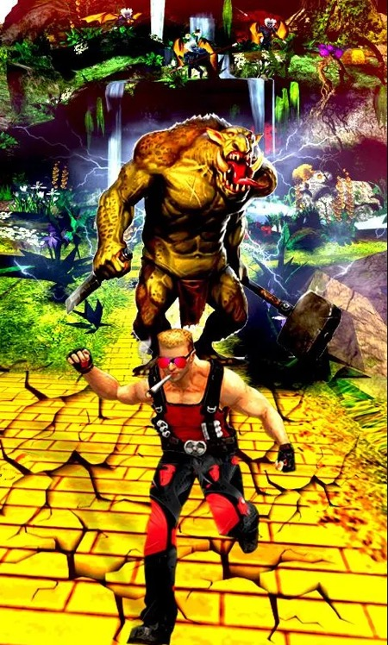
Color harmony
Do you feel comfortable/pleasant about the collocation of color?
Score 1
Score 5

Slide 13
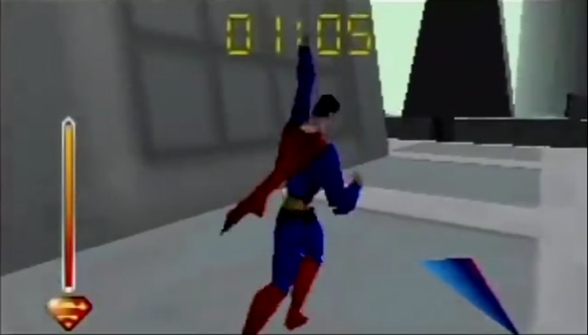
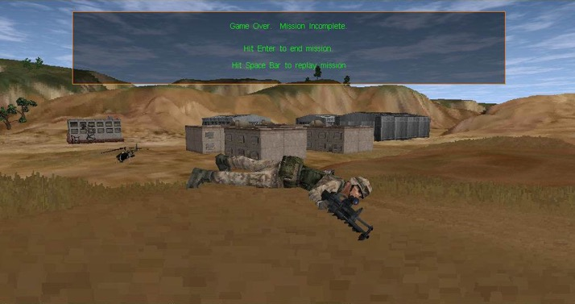
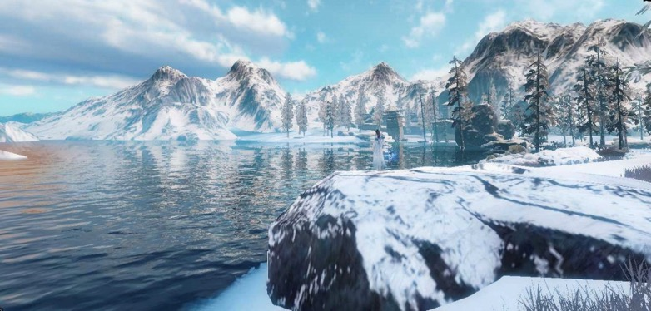
Overall score
Score 1
Score 5

Slide 14
Experiment
Participants
12 observers, 9 male and 3 female
an ongoing task, more observers will join
Game testers
Not designers, not artist, not working in game evaluation
Environment
Indoor, office environment
Display：HP P223A
Procedure
Adjust image size to simulate the visual field of mobile phone
5.9 inch at a 33.95-cm viewing distance
Evaluate four dimensions at the same time

Slide 15
Analysis
Score distribution
 | Fineness | Colorfulness | Harmony | Overall
Confidence interval | 0.550 | 0.512 | 0.542 | 0.547

Slide 16
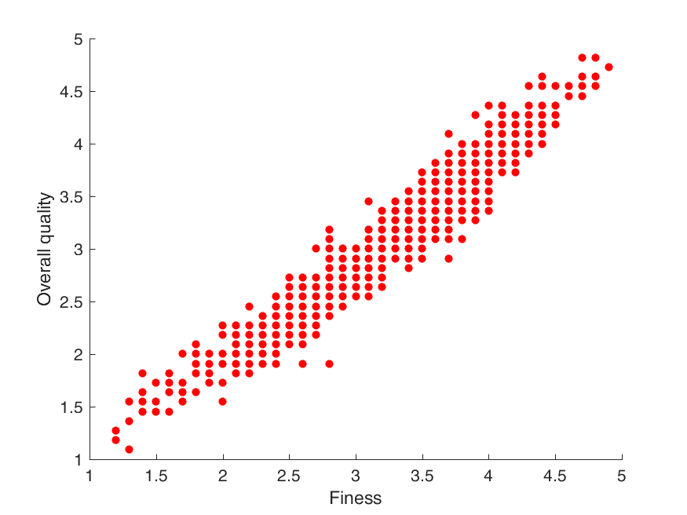
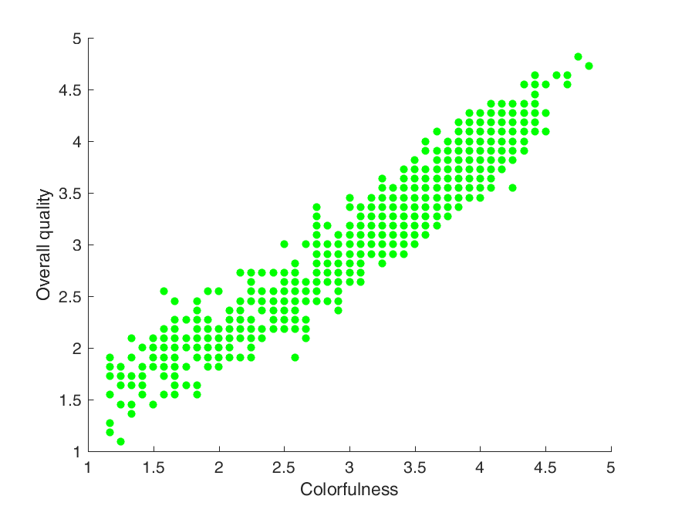
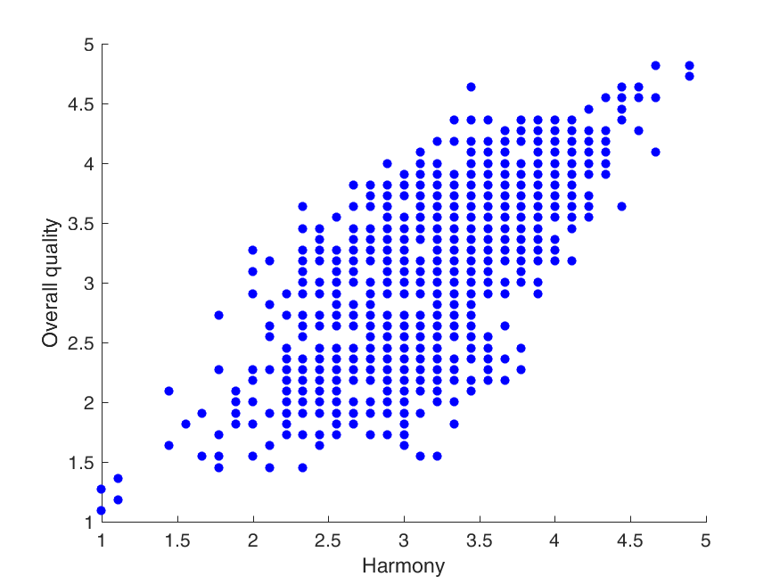
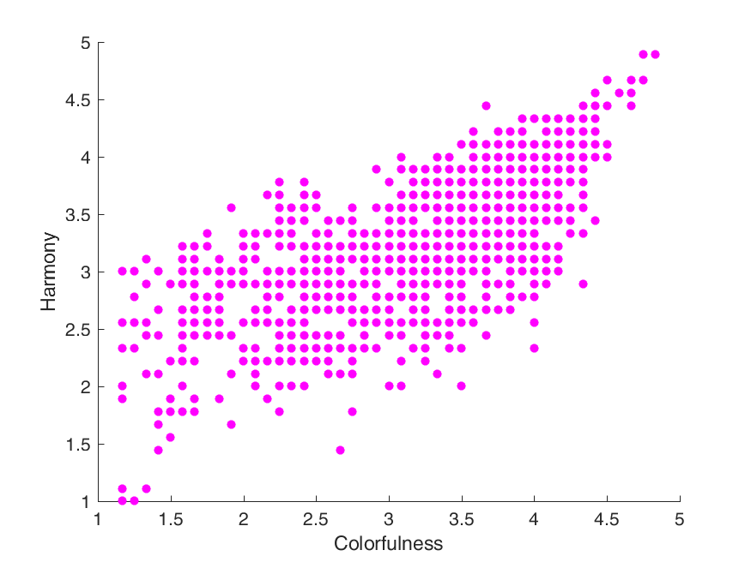
Analysis
Correlation of MOS among dimensions
Overall Quality
Harmony
CC=0.971
CC=0.960
CC=0.741
CC=0.696
Fineness
Colorfulness
Harmony
Colorfulness

Slide 17
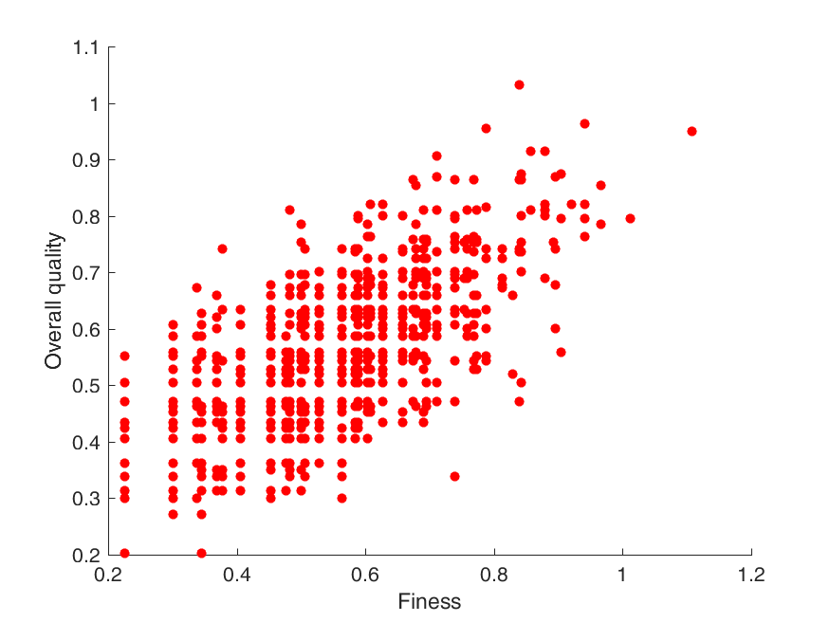
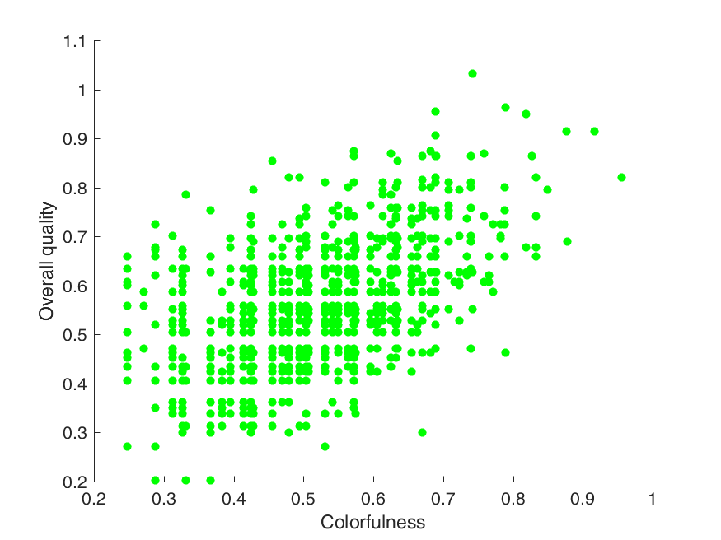
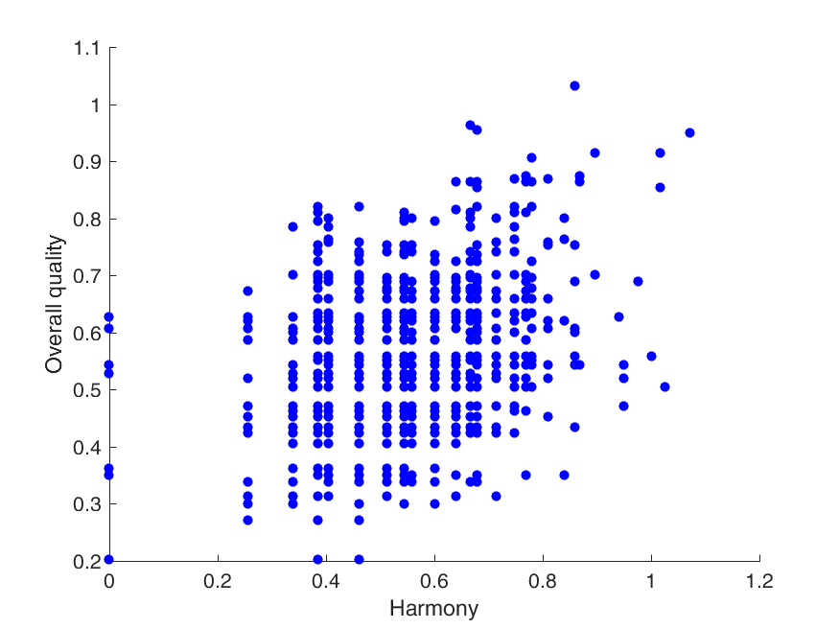
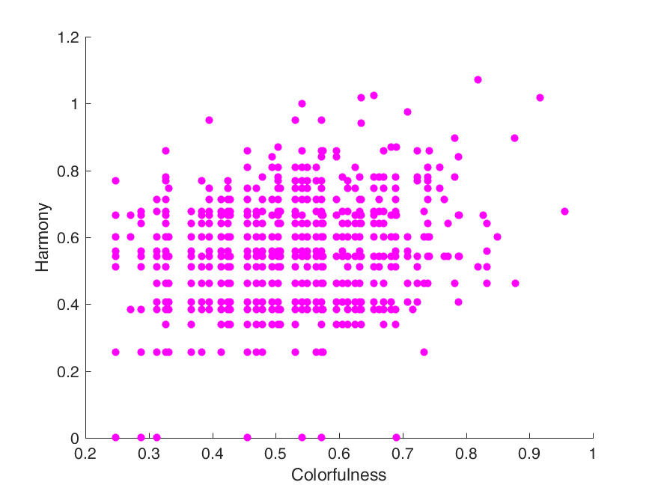
Analysis
Correlation of confidence interval between dimensions
Agreement among the observers
Overall Quality
Harmony
CC=0.684
CC=0.518
CC=0.318
CC=0.189
Fineness
Colorfulness
Harmony
Colorfulness

Slide 18
Analysis
Performance of objective metrics
PCC | fineness | colorfulness | harmony | overall_score
CPBD[1] | 0.58084924 | 0.60560647 | 0.43386353 | 0.52565376
NIMA[2] | 0.1547595 | 0.14222089 | 0.30302161 | 0.14776166
[1] Narvekar, Niranjan D., and Lina J. Karam. "A no-reference image blur metric based on the cumulative probability of blur detection (CPBD)." IEEE Transactions on Image Processing 20.9 (2011): 2678-2683.
[2] Talebi, Hossein, and Peyman Milanfar. "NIMA: Neural image assessment." IEEE Transactions on Image Processing 27.8 (2018): 3998-4011.

Slide 19
Future work
Some more dimensions to evaluate?
Objective metrics?
Other suggestions?

